Slide 1
The Evidence for LPAA
Life Participation Approach to Aphasia
Based on Simmons-Mackie, N. & Kagan, A. (2015). Research Evidence for Life Participation Intervention in Aphasia. Presented at the 2015 AphasiaAccess Leadership Summit, Boston
NOTE: The associated document, “Course Module: The Evidence for LPAA”, contains information regarding relevant standards/guidelines, learning objectives, additional learning materials, and assessment activities. The document “Summary of Research References” contains the references separated into categories.

Slide 2
Made Possible By Support From:

Slide 3
Academic Module Committee

Slide 4
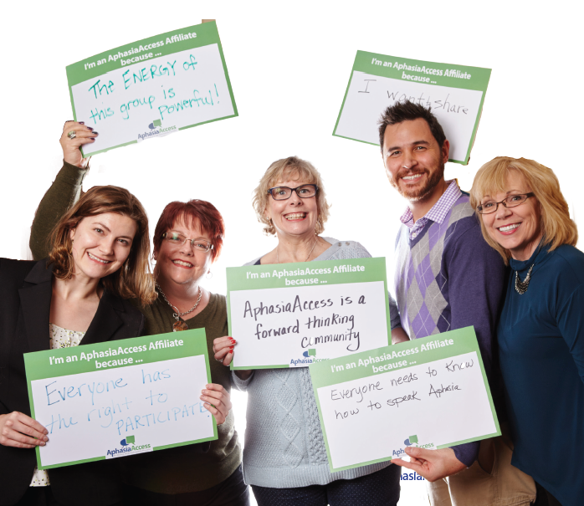
About Aphasia Access
Received its 501c(3) designation in May 2014
Membership includes representation from 33 states and 5 Canadian Provinces. The Life Participation Approach to Aphasia (LPAA) is the core philosophy.
Produces videos, webinars and podcasts that are used internationally to educate speech-language pathologists, healthcare professionals, students, nonprofit board members and community leaders.
Advocates for aphasia care and communication access throughout health care.

Slide 5
Two Types of Research
Research supporting need for LPAA
Treatment/intervention research
Notes:
There are basically two kinds of research related to LPAA.
The first kind of research demonstrates the need for LPAA. These studies encompass many different aspects of the treatment process. They explore the relationship of aphasia to depression and the negative outcomes that are associated with depression. They examine how well treatment goals set by SLPs match the desired treatment goals expressed by people with aphasia and their families. They assess what information people with aphasia and their families received during rehabilitation and how well that information met their needs. They interviewed people with aphasia and their families to discover the essential elements necessary to live successfully with aphasia. Finally, they identified barriers that limit people with aphasia from fully participating in life.
The second kind of research focuses on the efficacy of treatments and interventions that embody some aspect of LPAA. These studies also have a broad scope, and cover different domains of treatment from impairment to psychosocial factors.
The accompanying reference list of research studies contains examples of each kind of study that are summarized in this module. This is not meant to be a systematic or an exhaustive review; rather it is meant to highlight the kinds of evidence we have to date that relate to the need for and the efficacy of LPAA.

Slide 6
Research Supporting Need for LPAA
What is needed to live successfully with aphasia?
Five qualitative studies collectively report results of interviews with 40 PWA, 24 family members, and 25 SLPs
Key themes: engage in meaningful activities, have relationships, communicate with others, and feel positive
Conclusions: Treatment should be holistic AND treatment and research should report outcomes relating to key themes
Notes:
Participating in meaningful activities fostered independence, well-being, and a sense of purpose or usefulness.
Relationships with family, friends, and other people with aphasia provided a sense of connectedness, support, and positivity. Participants discussed how aphasia and others’ lack of knowledge about the condition interfered with such relationships, but also expressed the importance of maintaining relationships and developing new ones.
The ability to communicate with others was integral to all other themes. Perceptions that their communication was improving gave participants hope. They expressed the importance of having access to formal therapy services across time to help them remain actively engaged in communication recovery, especially when such services helped them incorporate communication practice into their everyday activities.
Participants discussed the challenge of remaining positive given their communication impairment, but stated that staying active and setting goals helped them through the difficult times.

Slide 7
Research Supporting Need for LPAA
Patient-centered goals
Four qualitative studies collectively report on interviews with 50 PWA, 48 family members, & 34 SLPs
Goals of PWA and family were related to activity and participation, SLP goals were related to impairment early in rehab and moved toward activity/participation later
Conclusion: PWA and families should be included in goal selection in order to achieve patient-centered goals
Notes:
People with aphasia wanted to communicate not only basic needs, but their opinions about things. They wanted goals that would help them achieve engagement in social, leisure, and work activities.
Family members wanted to be included in rehabilitation. They wanted to be able to communicate with the person with aphasia, and some wanted specific training. They discussed the importance of being provided with a sense of hope and positivity, especially in the early stages. They wanted information about aphasia and about available services. They wanted support to help them cope with their loved one’s aphasia and their own change in responsibilities that the stroke and aphasia necessitated.
Although the SLPs expressed goals that included impairment, activity, and participation, they expressed a tension in the early stages of rehabilitation, indicating that they needed to have specific, measurable,achievable, time-bound goals during that medically-oriented period of treatment, and inferring that more “functional” goals (i.e., activity and participation oriented) were better suited to later in the rehabilitation process.

Slide 8
Research Supporting Need for LPAA
Information needs
Three studies surveyed or interviewed 368 PWA and/or carers
Conclusion: Accessible information should be provided at onset and throughout the continuum of care
Notes:
Information about aphasia and recovery, communication strategies, and coping strategies were among the most common themes, but the specific information needed varied according to time post-onset.

Slide 9
Research Supporting Need for LPAA
Environmental barriers
Five studies and one meta-analysis (of three studies) identified environmental barriers to participation for PWA
PWA tended to be marginalized by societal barriers. Although barriers exist in multiple categories, often they can be reduced.
Conclusion:
Intervention should address the environment to reduce/eliminate barriers
Notes:
The barriers included other people (e.g., not checking to see whether the PWA has understood what has been said), physical barriers (e.g., unclear written information), and societal barriers (e.g., being required to write down information for service).

Slide 10
Research Supporting Need for LPAA
Low mood and depression
33%–79% of stroke survivors experience depression Incidence is higher (62%–70%) in stroke survivors with aphasia
Post-stroke depression associated with longer hospital stays, poorer functional recovery, higher mortality, and greater healthcare utilization
Low mood and depression risk does not abate after one year

Slide 11
Research Supporting Need for LPAA
Low mood and depression CONTINUED
Investment in psychological care after stroke will lead to reduction in health and social cares costs of 37% over two years
Caregivers of PWA have significantly worse outcomes than caregivers of stroke survivors without aphasia Increased risk of depression persists over time

Slide 12
Research Supporting Need for LPAA
Low mood and depression CONTINUED
Conclusion: Mood and depression should be targets of intervention

Slide 13
Treatment Studies Targeting Multiple ICF Domains
Community aphasia programs/centers Three studies measured outcomes of program “package”
All reported positive outcomes across environmental, psychosocial, participation, and QOL domains
Level of evidence low - case designs Little data in this area, but a promising start

Slide 14
Treatment Studies Targeting Multiple ICF Domains
Intensive Comprehensive Aphasia Programs (ICAPs)
Three studies measured outcomes of ICAPs
Results: positive outcomes in functional communication, language, and quality of life
Level of evidence low—case series designs Insufficient for strong recommendation, but good start

Slide 15
Treatment Studies Targeting Multiple ICF Domains
Aphasia Groups
Two systematic reviews (6 studies & 29 studies)
Evidence supports group therapy for improving language
Evidence is insufficient regarding participation or quality of life outcomes

Slide 16
Treatment Targeting a Single Domain
Intervention targeting the language impairment
Few language impairment studies reported impact of outcomes on participation and QOL
For example: Studies of word retrieval treatment tended to measure elements of structured discourse or conversation versus real-life communication situations

Slide 17
Treatment Targeting a Single Domain
Intervention targeting participation
Conversation therapy
One review of 30 papers included treatment focused on PWA and partner training
Positive outcomes for conversation (included two RCTs)
Need more research that separates treatment focused on PWA versus partner training

Slide 18
Treatment Targeting a Single Domain
Activity-focused intervention
Four studies with few participants reported success doing targeted activities
Not sufficient evidence to make recommendation

Slide 19
Treatment Targeting a Single Domain
Participation immersion
Two studies (n=14,13)
Reported outcomes of participation in a choir and a theatre group
Positive outcomes

Slide 20
Treatment Targeting a Single Domain
Intervention targeting the environment
Communication partner training
Four reviews including one systematic review of 31 studies
Partner training is effective for improving communication support skills of partners
Recommendation — should be done
Partner training is probably effective for improving communication/participation of individuals with chronic aphasia

Slide 21
Treatment Targeting a Single Domain
Family education
Two systematic reviews of family education including one focused on aphasia and one focused more broadly on stroke
Providing information improves knowledge of stroke and satisfaction with services
There is some suggestion that it positively influences mood
Need more information about impact on participation and QOL

Slide 22
Treatment Targeting a Single Domain
Low-tech AAC
Ten studies (seven single cases, three group studies with low Ns)
Reported positive outcomes for improved communication participation

Slide 23
Treatment Targeting a Single Domain
High-tech AAC
One systematic review of 14 studies
High-tech AAC has potential but must be evaluated on a case-by-case basis; no general recommendations are possible

Slide 24
Intervention Targeting Psychosocial Adjustment
Intervention for depression
Included cognitive behavioral therapy, narrative therapy, and family therapy
Four studies including one RCT
All resulted in positive outcomes of mood
Need more research on impact on participation and QOL
Recommended based on effectiveness for alleviating depression and for ethical reasons

Slide 25
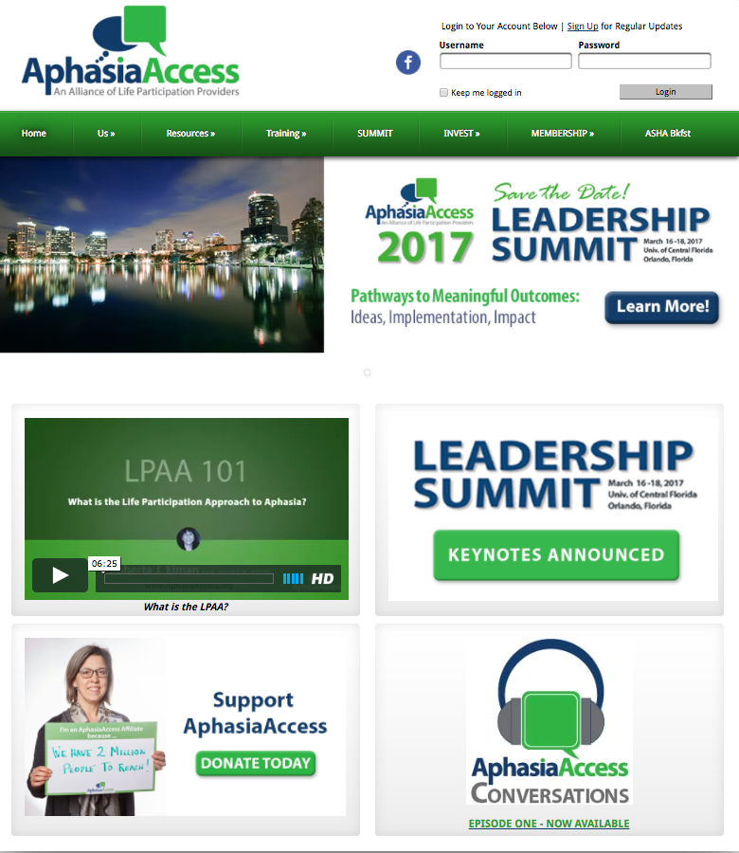
Aphasia Access Online
Archive of news stories and peer-reviewed articles on LPAA
Educational videos for people with aphasia, caregivers, and community stakeholders
Opportunities to get involved and support the growth of aphasia care, and LPAA
And much, much more.

